Slide 1
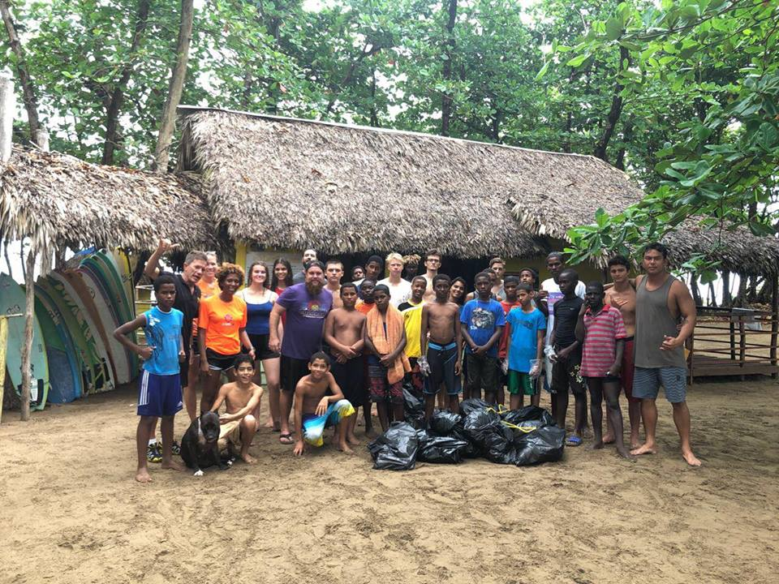
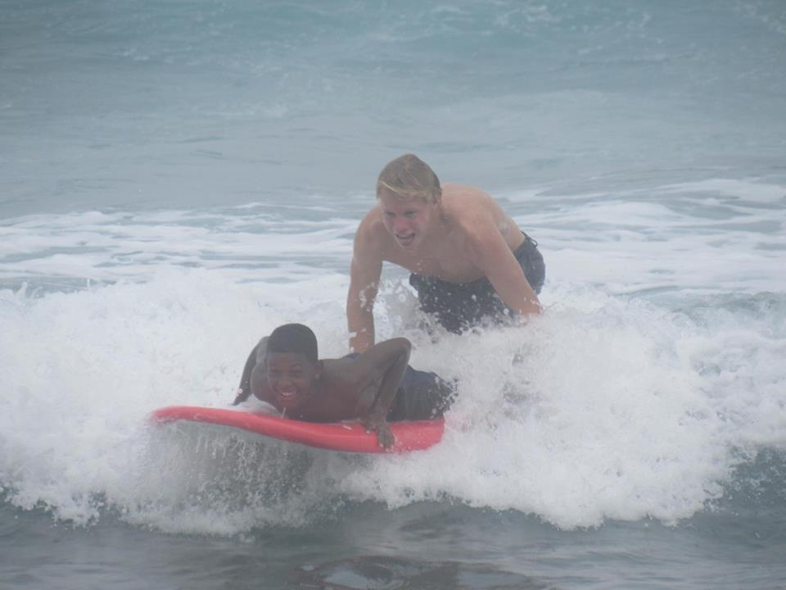
InSpire Dr
PBSL
Who is Inspire DR
Goals
Who should join?
Attendance Policy

Slide 2
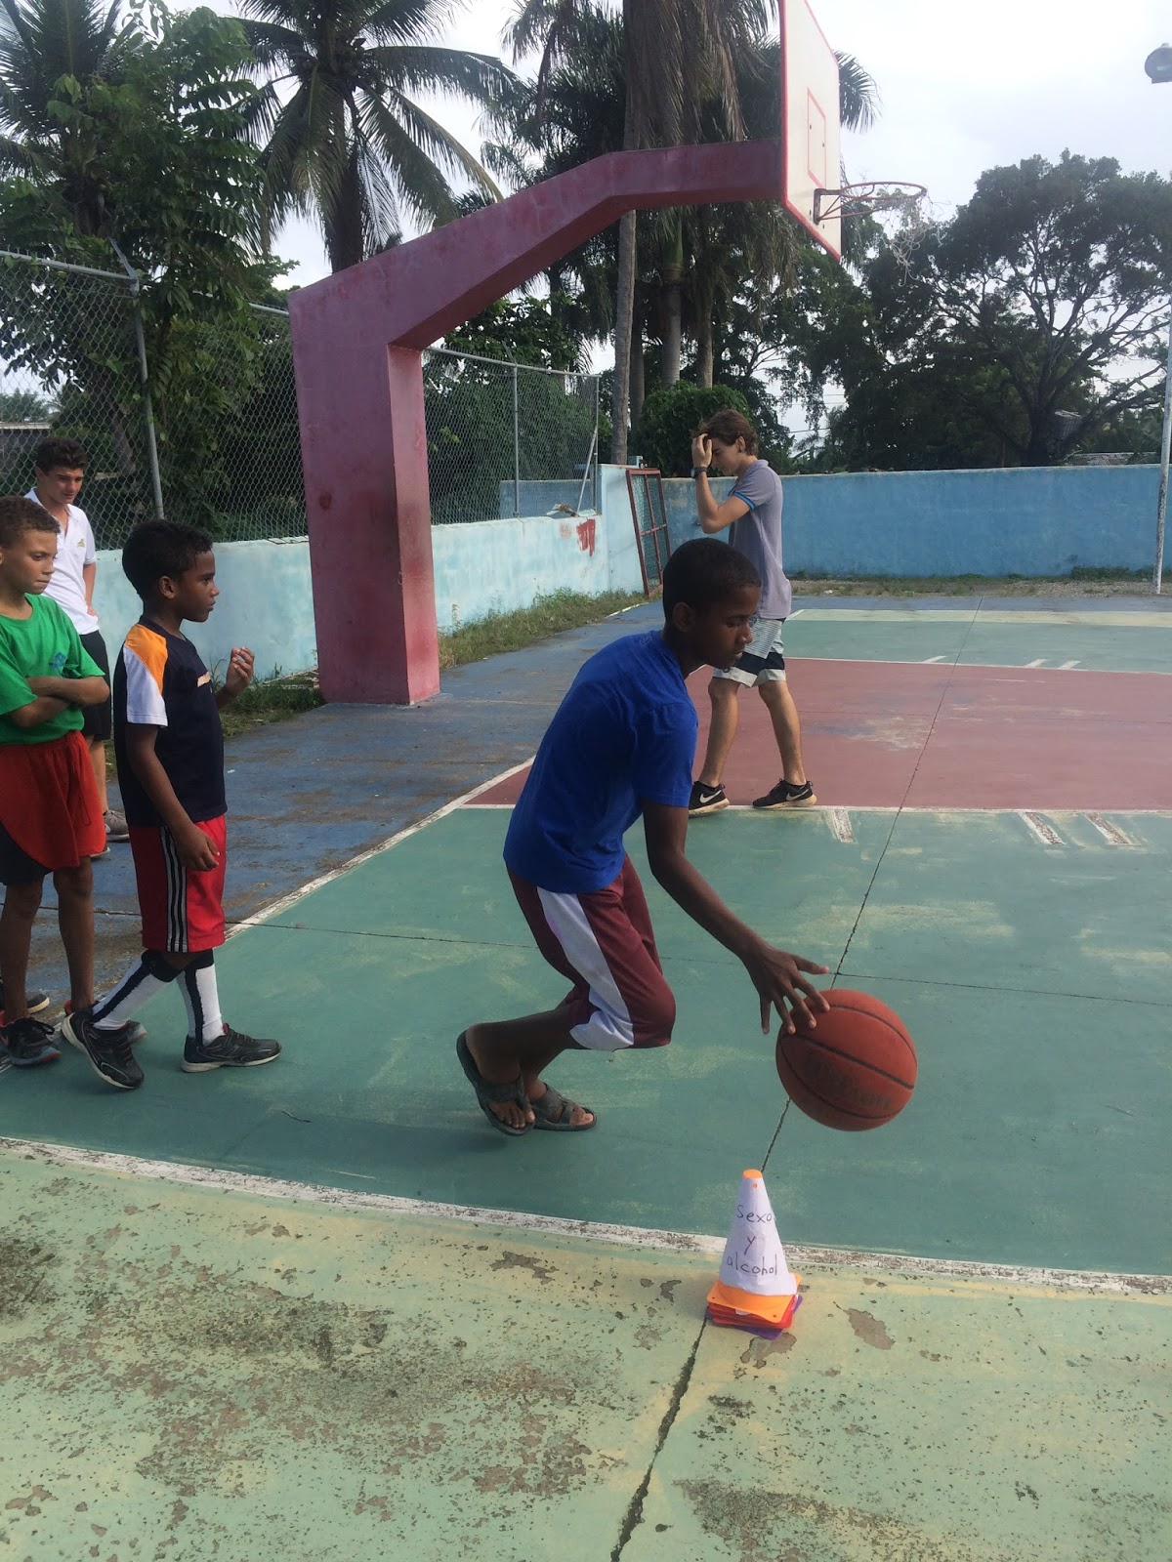
Who is Inspire?

Slide 3
Goals INSPIRE!
The goal of the Inspire DR PSBL is to support the Inspire DR non-profit organization in Cabarete. ISS students will visit and have the Inspire Boys visit and teach them basketball and other sports activities.
Students will also create learning projects for the Inspire boys when they are in class.
Mr. Calkins will also set up learning activities to support students that work with the Inspire boys.
Students will create posters, books, and materials to support Inspire students to learn English.

Slide 4
Who should join?
Somebody who
wants to Inspire people in the community to become good citizens through sports.
be a role model and make new friends.
willing to spend 2-3 hours a month off campus visiting Inspire teaching basketball and going to beach cleanups.
has a lot of energy and likes sports.

Slide 5
Who should join?
unafraid to talk and make new friends at Inspire.
willing to collaborate with student peers to solve a problem.
Wants to create projects and programs to help support Inspire students learning

Slide 6
Events
Beach Cleanups
Basketball visits
Creating Sports English Posters and Booklets
NO Shave November
Guest Speakers

Slide 7
Attendance
Students will visit Inspire and host the Inspire boys here about 2-3 hours a month. They will also be required to attend one beach cleanup a quarter. This will fulfill the ISS requirement of 15 community service hours per school year. It is expected that students attend all PBSL classes from 2:30-3:00 pm. If a student leaves school, there must be a reason from a parent emailed to Mr. Calkins and the ISS main office. Students may not miss PSBL lessons for other on campus clubs/activities or to see another teacher.

